Slide 2

C++17
Antony Polukhin
Полухин Антон
Boost libraries maintainer (DLL, LexicalCast, Any, TypeIndex, Conversion)
+ Boost.CircularBuffer, Boost.Variant
Представитель РГ21, national body

Slide 3
Оглавление
Автоматическое определение шаблонных парамеров классов
std::to_chars и std::from_chars
std::*_v<T..>
std::variant<T...>
std::in_place<T> и std::in_place<N>
О WG21
cond-word (init-statement; condition)
std::size()
Многопоточные алгоритмы
“Структурное связывание”
<number> / 105

Slide 4
Оглавление
constexpr лямбда функции
if constexpr
“Разделяемые” контейнеры std::*map и std::*set,
std::string_view
std::filesystem::*
Прочее...
<number> / 105

Slide 5
Автоматическое определение шаблонных параметров классов

Slide 6
Auto deduct class templates
// C++14
std::pair<int, double> p14_0(17, 42.0);
auto p14_1 = std::pair<int, double> (17, 42.0);
<number> / 105

Slide 7
Auto deduct class templates
// C++14
std::pair<int, double> p14_0(17, 42.0);
auto p14_1 = std::pair<int, double> (17, 42.0);
// C++17
std::pair p17_0(17, 42.0);
auto p17_1 = std::pair(17, 42.0);
<number> / 105

Slide 8
Auto deduct class templates
std::vector<int> v;
// C++14
typedef std::vector<int>::iterator v_iter;
std::pair<v_iter, v_iter>(v.begin(), v.end());
<number> / 105

Slide 9
Auto deduct class templates
std::vector<int> v;
// C++14
typedef std::vector<int>::iterator v_iter;
std::pair<v_iter, v_iter>(v.begin(), v.end());
// C++17
std::pair p(v.begin(), v.end());
<number> / 105

Slide 10
Almost-auto deduct class templates
template <typename EF> struct scope_exit;
auto foo() { /* очень много кода с return foo1(); */ };
// C++14
auto guard14 = foo();
<number> / 105

Slide 11
Almost-auto deduct class templates
template <typename EF> struct scope_exit;
auto foo() { /* очень много кода с return foo1(); */ };
// C++14
auto guard14 = foo();
// C++17
scope_exit guard17 = foo();
<number> / 105

Slide 12
Auto deduct class templates
namespace std {
template <class T1, class T2>
struct pair {
// ...
constexpr pair(const T1& x, const T2& y);
// ...
};
}
<number> / 105

Slide 13
Auto deduct class templates
namespace std {
template <class T1, class T2>
constexpr pair(const T1& x, const T2& y) -> pair<T1, T2>;
}
<number> / 105

Slide 14
Auto deduct class templates
std::vector<int> v;
std::pair p(v.begin(), v.end());
<number> / 105

Slide 15
Auto deduct class templates
std::vector<int> v;
std::pair p(v.begin(), v.end());
// auto p = std::pair(v.begin(), v.end());
<number> / 105

Slide 16
Auto deduct class templates
std::vector<int> v;
std::pair p(v.begin(), v.end());
// auto p = std::pair(v.begin(), v.end());
// template <class T1, class T2> pair(const T1& x, const T2& y) -> pair<T1, T2>;
<number> / 105

Slide 17
Auto deduct class templates
std::vector<int> v;
std::pair p(v.begin(), v.end());
// auto p = std::pair(v.begin(), v.end());
// template <class T1, class T2> pair(const T1& x, const T2& y) -> pair<T1, T2>;
// T1 == std::vector<int>::iterator
// T2 == std::vector<int>::iterator
<number> / 105

Slide 18
Almost-auto deduct class templates
// C++14
std::array<char, ???> a2{"Hello word"};
<number> / 105

Slide 19
Almost-auto deduct class templates
// C++17
namespace std {
// deduction guide
template <class T, size_t N> array(const T (&array)[N]) -> array<T, N>;
}
std::array a2{"Hello word"}; // deduces the type `std::array<char, 11>`
<number> / 105

Slide 20
std::to_chars и std::from_chars

Slide 21
std::to_chars и std::from_chars
#include <sstream> // :-(
template <class T>
T to_number_14(const std::string& s) {
T res{};
std::ostringstream oss(s); // :-(
oss >> res;
return res;
}
<number> / 105

Slide 22
std::to_chars и std::from_chars
template<typename _Facet>
locale::locale(const locale& __other, _Facet* __f) {
_M_impl = new _Impl(*__other._M_impl, 1);
__try { _M_impl->_M_install_facet(&_Facet::id, __f); }
__catch(...) {
_M_impl->_M_remove_reference();
__throw_exception_again;
}
delete [] _M_impl->_M_names[0];
_M_impl->_M_names[0] = 0; // Unnamed.
}
<number> / 105

Slide 23
std::to_chars и std::from_chars
#include <utility>
template <class T>
T to_number_17(const std::string& s) {
T res{};
std::from_chars(s.data(), s.data() + s.size(), res); // :-)
return res;
}
<number> / 105

Slide 24
std::*_v<T...>

Slide 25
std::*_v<T...>
// In <type_traits>
// template<class T, class U> struct is_same;
// C++14
std::cout << std::is_same<T1, T2>::value;
<number> / 105

Slide 26
std::*_v<T...>
// In <type_traits>
// template<class T, class U> struct is_same;
// C++14
std::cout << std::is_same<T1, T2>::value;
// C++17
std::cout << std::is_same_v<T1, T2>;
<number> / 105

Slide 27
std::*_v<T...>
template<class T, class U>
constexpr bool is_same_v = is_same<T, U>::value;
<number> / 105

Slide 28
std::variant<T...>

Slide 29
std::variant<T...>
#include <variant>
std::variant<int, std::string, double> v;
<number> / 105

Slide 30
std::variant<T...>
#include <variant>
std::variant<int, std::string, double> v;
union {
int __a;
std::string __b;
double __c;
};
<number> / 105

Slide 31
std::variant<T...>
#include <variant>
std::variant<int, std::string, double> v;
union {
int __a;
std::string __b;
double __c;
};
boost::variant<int, std::string, double> v;
<number> / 105

Slide 32
std::variant<T...>
std::variant не аллоцирует память для собственных нужд
<number> / 105

Slide 33
std::variant<T...>
#include <variant>
std::variant<int, std::string, double> v;
<number> / 105

Slide 34
std::variant<T...>
#include <variant>
std::variant<int, std::string, double> v;
v = 10;
assert(std::get<int>(v) == 10);
assert(std::get<0>(v) == 10);
<number> / 105

Slide 35
std::variant<T...>
#include <variant>
std::variant<int, std::string, double> v;
v = 10;
assert(std::get<int>(v) == 10);
assert(std::get<0>(v) == 10);
v = "Hello";
assert(std::get<std::string>(v) == "Hello");
assert(std::get<1>(v) == "Hello");
<number> / 105

Slide 36
std::variant<T...>
std::variant<int, double> int_or_double{ 42.0 };
<number> / 105

Slide 37
std::variant<T...>
std::variant<int, double> int_or_double{ 42.0 };
// std::get<std::string>(int_or_double);
<number> / 105

Slide 38
std::variant<T...>
std::variant<int, double> int_or_double{ 42.0 };
// std::get<std::string>(int_or_double);
assert(std::get_if<int>(&int_or_double) == nullptr);
<number> / 105

Slide 39
std::variant<T...>
std::variant<int, double> int_or_double{ 42.0 };
// std::get<std::string>(int_or_double);
assert(std::get_if<int>(&int_or_double) == nullptr);
int_or_double = 17;
assert(*std::get_if<int>(&int_or_double) == 17);
<number> / 105

Slide 40
std::variant<T...>
constexpr std::variant<int, float> int_or_float{17};
<number> / 105

Slide 41
std::variant<T...>
constexpr std::variant<int, float> int_or_float{17}; // noexcept
<number> / 105

Slide 42
std::variant<T...>
constexpr std::variant<int, float> int_or_float{17}; // noexcept
<number> / 105

Slide 43
std::variant<T...>
constexpr std::variant<int, float> int_or_float{17}; // noexcept
Deleter d{ /* ... */ };
std::variant<int, std::shared_ptr<int> > v{std::in_place<1>, nullptr, std::move(d)};
<number> / 105

Slide 44
std::variant<T...>
constexpr std::variant<int, float> int_or_float{17}; // noexcept
Deleter d{ /* ... */ };
std::variant<int, std::shared_ptr<int> > v{std::in_place<1>, nullptr, std::move(d)};
<number> / 105

Slide 45
std::in_place

Slide 46
std::in_place<T> and std::in_place<N>
std::variant<std::string, int> vari(in_place<0>, v.begin(), v.end());
std::optional<std::string> opti(in_place, v.begin(), v.end());
std::any anys(in_place<std::string>, v.begin(), v.end());
<number> / 105

Slide 47
std::in_place<T> and std::in_place<N>
struct in_place_tag {};
template <class T> in_place_tag in_place(unspecified1<T>) { return {}; };
template <int I> in_place_tag in_place(unspecified2<I>) { return {}; };
in_place_tag in_place(unspecified3) { return {}; };
<number> / 105

Slide 48
std::in_place<T> and std::in_place<N>
template <class T> struct unspecified1{};
template <std::size_t I> struct unspecified2{};
struct unspecified3{};
struct in_place_tag {};
template <class T> in_place_tag in_place(unspecified1<T>) { return {}; };
template <int I> in_place_tag in_place(unspecified2<I>) { return {}; };
in_place_tag in_place(unspecified3) { return {}; };
<number> / 105

Slide 49
std::in_place<T> and std::in_place<N>
template <class T>
using in_place_type_t = in_place_tag(&)(unspecified1<T>);
template <int I>
using in_place_index_t = in_place_tag(&)(unspecified2<I>);
using in_place_t = in_place_tag(&)(unspecified3);
<number> / 105

Slide 50
WG21

Slide 51
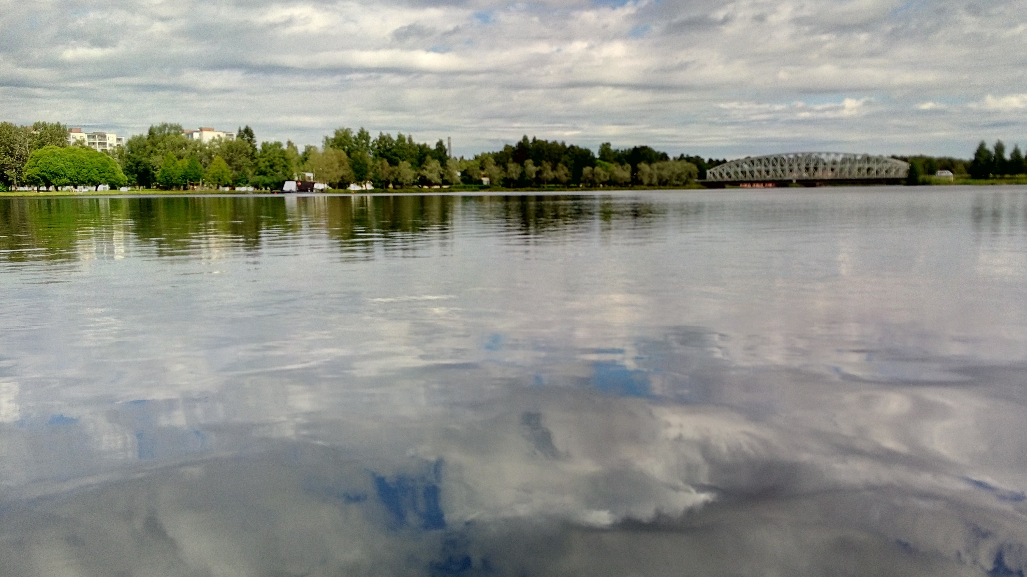
<number> / 105

Slide 52
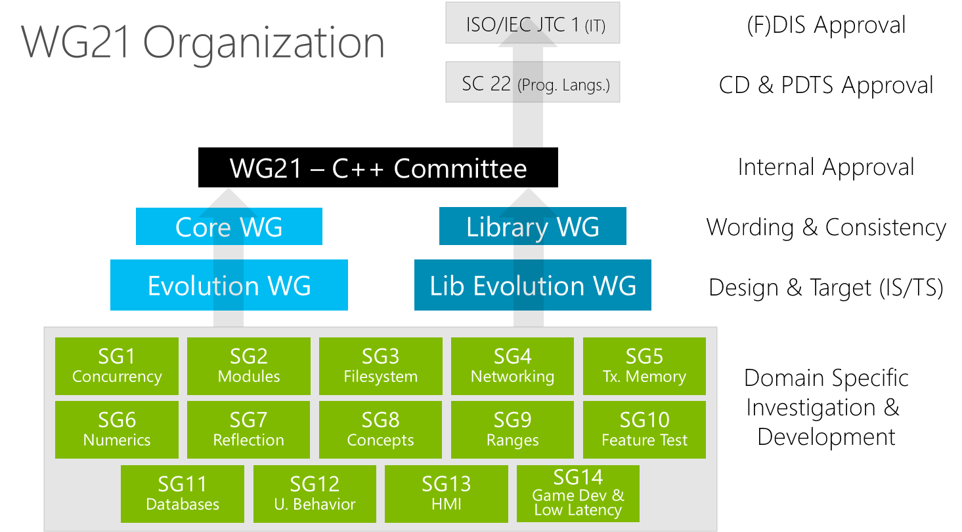
<number> / 105

Slide 53
Инициализация в условных выражениях

Slide 54
cond-word (init-statement; condition)
if (auto state = get_state(); is_good(state)) {
do_something(state);
} else {
std::cerr << "Bad state:" << state;
}
<number> / 105

Slide 55
cond-word (init-statement; condition)
if (auto state = get_state(); is_good(state)) {
switch (std::lock_guard lk(m); state) {
case ONE: /* ... */ break;
case TWO: /* ... */ break;
}
do_something(state);
} else {
std::cerr << "Bad state:" << state;
}
<number> / 105

Slide 56
cond-word (init-statement; condition)
if (auto state = get_state(); is_good(state)) {
switch (std::lock_guard lk(m); state) {
case ONE: /* ... */ break;
case TWO: /* ... */ break;
}
do_something(state);
} else {
std::cerr << "Bad state:" << state;
}
<number> / 105

Slide 57
cond-word (init-statement; condition)
if (auto state = get_state(); is_good(state)) {
switch (std::lock_guard lk(m); state) {
case ONE: /* ... */ break;
case TWO: /* ... */ break;
}
do_something(state);
} else {
std::cerr << "Bad state:" << state;
}
<number> / 105

Slide 58
cond-word (init-statement; condition)
if (auto state = get_state(); is_good(state)) {
switch (std::lock_guard lk(m); state) {
case ONE: /* ... */ break;
case TWO: /* ... */ break;
}
do_something(state);
} else {
std::cerr << "Bad state:" << state;
}
<number> / 105

Slide 59
std::size

Slide 60
std::size
int a[] = { -5, 10, 15 };
// ...
for (size_t i = 0; i < std::size(a); ++i)
std::cout << a[i] << ',';
<number> / 105

Slide 61
std::size
template <class T, std::size_t N>
constexpr std::size_t size(const T (&)[N]) noexcept {
return N;
}
<number> / 105

Slide 62
Многопоточные алгоритмы

Slide 63
MT algorithms
std::vector<int> v;
v.reserve(100500 * 1024);
some_function_that_fills_vector(v);
// Многопоточная сортировка данных
std::sort(std::execution::par, v.begin(), v.end());
<number> / 105

Slide 64
MT algorithms
std::vector<int> v;
v.reserve(100500 * 1024);
some_function_that_fills_vector(v);
// Многопоточная сортировка данных
std::sort(std::execution::par, v.begin(), v.end());
<number> / 105

Slide 65
MT algorithms
std::vector<int> v;
v.reserve(100500 * 1024);
some_function_that_fills_vector(v);
// Многопоточная сортировка данных
std::sort(std::execution::par, v.begin(), v.end());
// In <execution>:
// std::execution::seq
// std::execution::par
// std::execution::par_unseq
<number> / 105

Slide 66
MT algorithms
std::sort(std::execution::par, v.begin(), v.end(), [](auto left, auto right) {
if (!left || !right)
throw std::logic_error("Zero values are not expected"); // std::terminate()
return left < right;
});
<number> / 105

Slide 67
MT algorithms
const bool not_ok = std::any_of(
std::execution::par, v.cbegin(), v.cend(), [](auto v) noexcept { return !v; }
);
if (not_ok)
throw std::logic_error("Zero values are not expected");
std::sort(std::execution::par, v.begin(), v.end(), [](auto left, auto right) noexcept {
return left < right;
});
<number> / 105

Slide 68
Структурное связывание

Slide 69
Structured binding
auto safe_info_14() {
auto d = get_device_info();
if (!d.first) // first? Что в нём хранится?
throw safe_info_exception();
return d.second; // second?
}
<number> / 105

Slide 70
Structured binding
using device_info
= std::array<char, 1024 * 640>; // 640КБ должно быть достаточно для каждого :)
std::pair<bool, device_info> get_device_info() noexcept;
auto safe_info_14() {
auto d = get_device_info();
if (!d.first) // first? Что в нём хранится?
throw safe_info_exception();
return d.second; // second?
}
<number> / 105

Slide 71
Structured binding
auto safe_info_17() {
auto [ok, info] = get_device_info();
if (!ok)
throw safe_info_exception();
return info;
}
<number> / 105

Slide 72
Structured binding
struct point {
point() = delete;
long double dimensions[3];
};
point& get_point_of_interest();
<number> / 105

Slide 73
Structured binding
struct point {
point() = delete;
long double dimensions[3];
};
point& get_point_of_interest();
// ...
auto& [x, y, z] = get_point_of_interest();
x += 42.0;
y += 17.0;
z += 3.14;
<number> / 105

Slide 74
Structured binding
std::map<int, short> m;
// ...
for (auto& [client_id, port]: m) {
port = ::open_port_for(client_id);
}
<number> / 105

Slide 75
Constexpr lambda

Slide 76
Constexpr lambda
template <class... T>
constexpr bool to_bool(const std::variant<T...>& var);
<number> / 105

Slide 77
Constexpr lambda
template <class... T>
constexpr bool to_bool(const std::variant<T...>& var) {
if (var.valueless_by_exception())
return false;
<number> / 105

Slide 78
Constexpr lambda
template <class... T>
constexpr bool to_bool(const std::variant<T...>& var) {
if (var.valueless_by_exception())
return false;
return std::visit([](const auto& v) -> bool {
return v;
}, var);
}
<number> / 105

Slide 79
Constexpr lambda
template <class... T>
constexpr bool to_bool(const std::variant<T...>& var) {
if (var.valueless_by_exception())
return false;
return std::visit([](const auto& v) -> bool {
return v;
}, var);
}
<number> / 105

Slide 80
Constexpr lambda
template <class... T>
constexpr bool to_bool(const std::variant<T...>& var) {
if (var.valueless_by_exception())
return false;
return std::visit([](const auto& v) -> bool {
return v;
}, var);
}
<number> / 105

Slide 81
if constexpr

Slide 82
if constexpr
template <class ...T>
auto vectorize(const T&... args) {
constexpr std::size_t vector_length = 3u;
constexpr std::size_t count = sizeof...(args);
// ...
<number> / 105

Slide 83
if constexpr
template <class ...T>
auto vectorize(const T&... args) {
constexpr std::size_t vector_length = 3u;
constexpr std::size_t count = sizeof...(args);
if constexpr (count % vector_length != 0) {
return vectorize(args..., 0);
} else {
return compute(args...);
}
}
<number> / 105

Slide 84
Splicing Maps and Sets

Slide 85
Splicing Maps and Sets
struct user {
std::string bio;
std::string address;
std::vector<unsigned char> photo;
std::array<unsigned char, 128> key;
// ...
};
<number> / 105

Slide 86
Splicing Maps and Sets
class user_registry {
std::unordered_map<std::string, user> data_;
public:
void update(const std::string& old_name, std::string new_name);
};
86 / 105

Slide 87
Splicing Maps and Sets
// C++14
void user_registry::update(const std::string& old_name, std::string new_name) {
auto it = data_.find(old_name);
if (it == data_.cend())
return;
user user_copy = std::move(it->second);
data_.erase(it);
data_.emplace(std::move(new_name), std::move(user_copy));
}
<number> / 105

Slide 88
Splicing Maps and Sets
// C++17
void user_registry::update(const std::string& old_name, std::string new_name) {
auto node = data_.extract(old_name);
if (!node)
return;
node.key() = std::move(new_name);
data_.insert(std::move(node));
}
<number> / 105

Slide 89
std::string_view

Slide 90
std::string_view
// C++14
void foo(const std::string& value);
<number> / 105

Slide 91
std::string_view
// C++14
void foo(const std::string& value);
void foo(const char* value);
<number> / 105

Slide 92
std::string_view
// C++14
void foo(const std::string& value);
void foo(const char* value);
void foo(const char* value, std::size_t length);
<number> / 105

Slide 93
std::string_view
// C++14
void foo(const std::string& value);
void foo(const char* value);
void foo(const char* value, std::size_t length);
// C++17
void foo(std::string_view value);
<number> / 105

Slide 94
std::string_view
// C++14
template <class CharT>
void foo(const std::basic_string<CharT>& value);
template <class CharT>
void foo(const CharT* value);
template <class CharT>
void foo(const CharT* value, std::size_t length);
<number> / 105

Slide 95
std::string_view
// C++17
template <class CharT>
void foo(std::basic_string_view<CharT> value);
<number> / 105

Slide 96
std::filesystem

Slide 97
std::filesystem
#include <filesystem>
#include <iostream>
int main() {
std::filesystem::directory_iterator it("./");
std::filesystem::directory_iterator end;
for (; it != end; ++it) {
std::filesystem::file_status fs = it->status();
// ...
<number> / 105

Slide 98
std::filesystem
std::filesystem::file_status fs = it->status();
switch (fs.type()) {
case std::filesystem::file_type::regular:
std::cout << "FILE ";
break;
case std::filesystem::file_type::symlink:
std::cout << "SYMLINK ";
break;
case std::filesystem::file_type::directory:
std::cout << "DIRECTORY ";
break;
<number> / 105

Slide 99
std::filesystem
if (fs.permissions() & std::filesystem::owner_write) {
std::cout << "W ";
} else {
std::cout << " ";
}
std::cout << it->path() << '\n';
} /*for*/
} /*main*/
<number> / 105

Slide 100
std::filesystem
using namespace std::filesystem;
path read_symlink(const path& p);
path read_symlink(const path& p, std::error_code& ec);
<number> / 105

Slide 101
std::filesystem
using namespace std::filesystem;
path read_symlink(const path& p);
path read_symlink(const path& p, std::error_code& ec);
<number> / 105

Slide 102
std::filesystem
using namespace std::filesystem;
path read_symlink(const path& p);
path read_symlink(const path& p, std::error_code& ec);
<number> / 105

Slide 103
Прочее...

Slide 104
Прочее...
memory_order_consume
std::function's allocators
std::iterator/std::get_temporary_buffer/std::is_literal_type
template <auto V> struct …
std::any
std::optional
[*this](){ /* ... */ }
Math special functions
Inline variables
namespace foo::bar::example { /* ... */ }
<number> / 105

Slide 105
Спасибо! Вопросы?
<number> / 105

